Slide 1
Biological art – the grotesque and dark tourism
Nik Brown and Emily Phillips

Slide 2
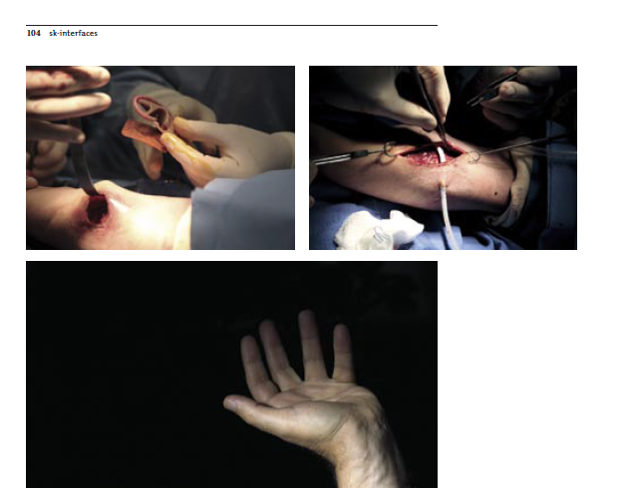
Dark biology – grotesque imaginaries
Nik Brown and Emily Phillips (University of York)

Slide 3
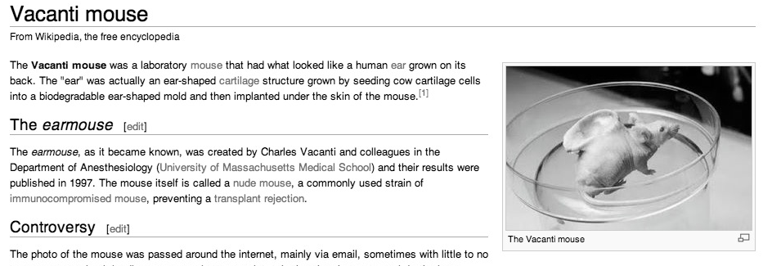
Dark biology – grotesque imaginaries

Slide 4
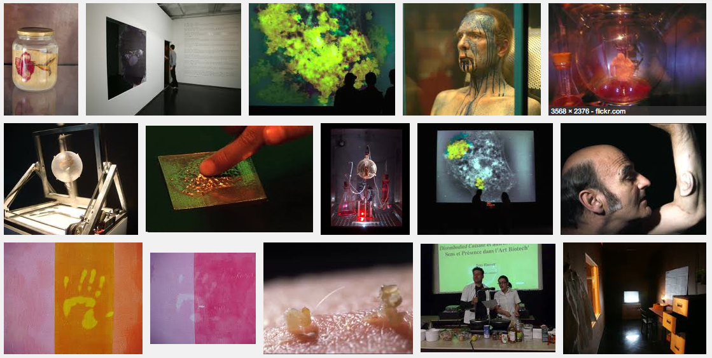
Dark biology – grotesque imaginaries

Slide 5
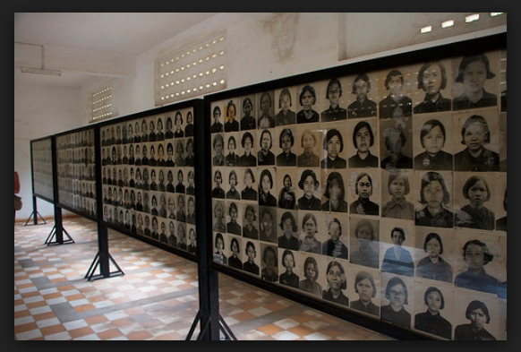
Dark biology – grotesque imaginaries
Dark tourism
Consuming traces of decay, catastrophe…
Thanatological scenographies (Stone and Sharpley 2008)
From the remnants of death to a preoccupation with ‘life’ (Walters 2004)
Bioart
Dark tourism premised on the proliferative liveliness of dark objects – vitalistic generativity

Slide 6
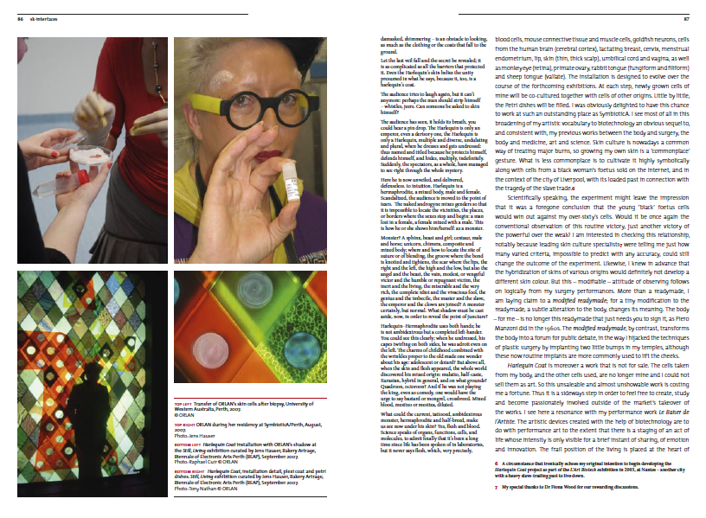
Dark biology – grotesque imaginaries

Slide 7
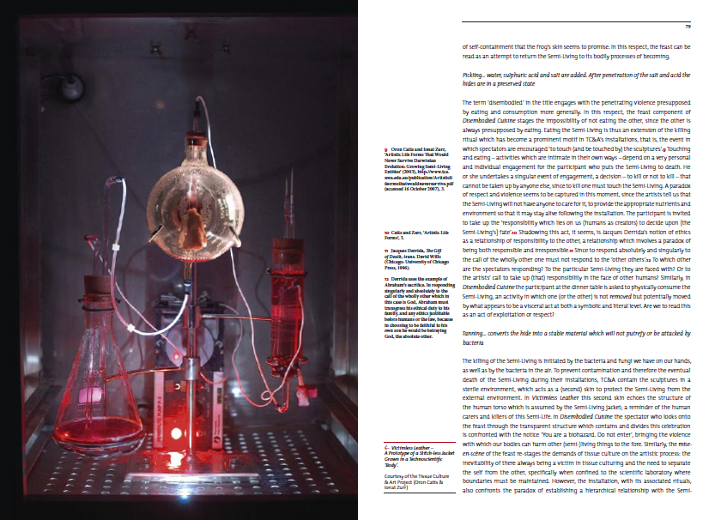
Dark biology – grotesque imaginaries

Slide 8
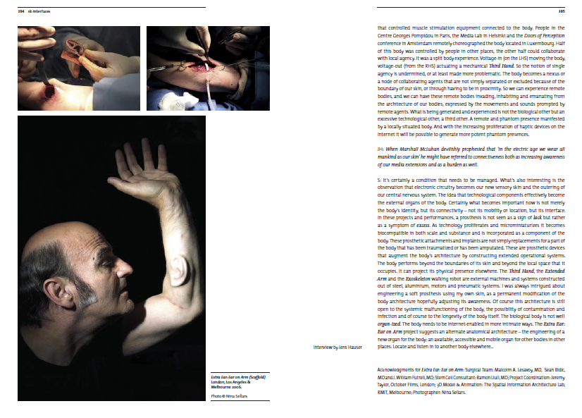
Dark biology – grotesque imaginaries

Slide 9
Dark biology – grotesque imaginaries
Performing dark biology
“[W] hen the concept was developed [...] there was nothing. … very little consideration into issues of corporate legal responsibility, public relations and health & safety because [they] had all been seduced into the dark side of the exhibition and how fantastic would it be...” (Operations Manager)

Slide 10
Dark biology – grotesque imaginaries
Dark biology as dark tourism
‘...it’s like they’ve hidden all the, the kind of ghoulish stuff in here!” (educational support worker, 30-40 years).
‘[...] it’s just cos it’s just all dead things, and it doesn’t feel... Well, they might not all be dead, but that sort of thing doesn’t feel to me like art. It’s not something that I’d usually choose to go and see.’ (graphic design student, 18-30 years).

Slide 11
Dark biology – grotesque imaginaries
Dark biology as dark tourism
G1: That fur coat… G2: I didn’t like that, I didn’t want that there. I mean, eurgh. (shudders, acts out the shape of the hanging coat)
G1: Like some kind of a ghost or something
G3: do you think it was meant to be the ghost of someone who killed themselves in this exhibition?!
G: It just makes you feel sick that these little creatures, they were wearing that coat, and now somebody else is. It’s not nice. I don’t like it.

Slide 12
Dark biology – grotesque imaginaries
Dark biology as dark tourism
V: [...] you get relics in a church, they have that same sort of… sort of value, that shock value to a degree. .. churches and .. museums and they have the relics on display … It’s very sinister, [...] he’s looked at it in terms of technology …
T: like the Capuchin monks you were telling me about
V: yeah they had all the monks of the order… all the skeletons and they’re shrouded in the monks’ outfits and they’re all up against the wall, and they’re all, you know, dead skeletons, and there’s a very old plaque that one of them is holding and it says something like ‘what you are now, we once were’ …

Slide 13
Dark biology – grotesque imaginaries
Dark biology as dark tourism
L1: …I’m dark, I’m not jewish, but I have a fascination with concentration camps. .. I’ve been to Dachau and to Auswitz … I look at the shoes and I think there’s somebody…
L3: and they’ve got a lamp shade made out of the skin…
L1: but I do have a fascination. And I think, why have I got this fascination?
E: maybe it’s because you just can’t understand it [...]?
L1: yeah, I’m trying to comprehend it maybe
L2: but a lot of this [exhibition] is what you can do with the human body, yet you read some of those books when they were in these camps and torturing them in different ways …Now, they teach you a lot about what you can do with the human body. You know, but this [exhibition] is not for that reason. It’s something different …

Slide 14
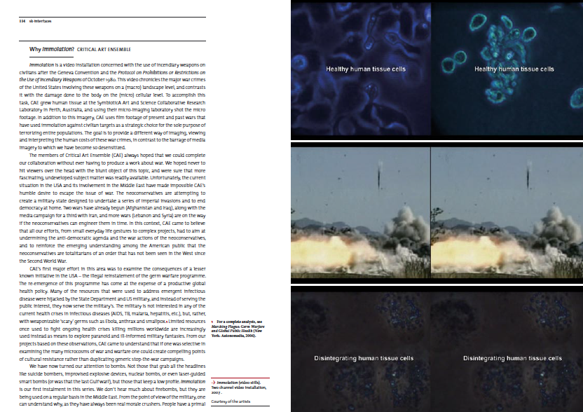
Dark biology – grotesque imaginaries

Slide 15
Dark biology – grotesque imaginaries
Dark biology as dark tourism
“ [...] I almost wanted to see the images of that tissue culture being kind of destroyed.” (Theatre Director and University Researcher, 30-40)
“… the phosphorous bombings and things like that, I just couldn’t stop watching that because it’s quite hypnotic. It’s almost like… in a really weird way … you want to see someone’s skin burning in a really sick way. I don’t know why though! When he’s putting that phosphorous on it and all the skin bubbles and stuff, I don’t like, [pause] I don’t know, it’s almost like pleasurable watching it! And it’s sick isn’t it? It’s not nice. It’s like the way when you burn your skin and you see it spreading across [...] ” (Accountant, 18-30)

Slide 16
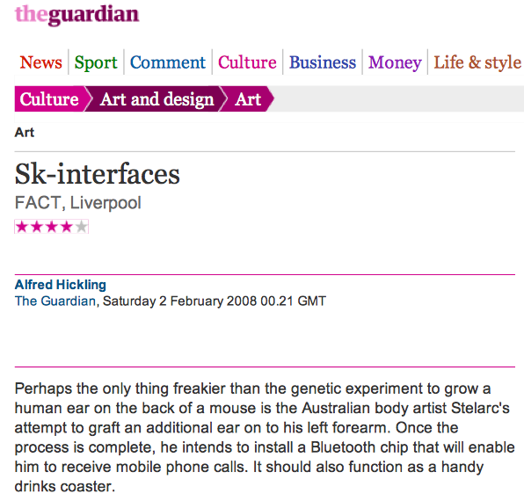
Dark biology – grotesque imaginaries
Traces of earmouse

Slide 17
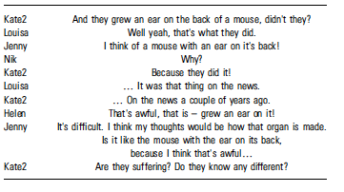
Dark biology – grotesque imaginaries
Traces of earmouse
Brown, N. (2006). The visual politics of animals in bioscience–Earmice in the public sphere. Xenotransplantation, 13(6), 501-505.
Franklin, Sarah (2003) ‘Drawing the Line at Not-fully-human: What We Already Know’, American Journal of Bioethics 3(3): 25–6.

Slide 18
Dark biology – grotesque imaginaries
Traces of earmouse
J: I wasn’t happy with it... You know it was a bit too much in your face… I was a bit in awe of it. I was when I saw the little mouse on the television with the ear on his back, but I thought about it and I see that it is progress, and it might help people medically and all that, so you might as well take an interest anyway because it is the future sort of thing…
… the growths growing on the side of the arm, that didn’t come at me too much. But I’m still not happy when I see a picture of an ear on a mouse. I don’t know whether it’s the animal loving side of me, or it’s just a visual thing.
… it’s maybe a bit too explicit… where you had the big visual of the mouse on screen, I think you didn’t need to have a big visual because you’ve already seen the process with the small visuals…

Slide 19
Dark biology – grotesque imaginaries
Traces of earmouse
T: .. we spent a long time in all the galleries looking at everything … I remember seeing a mouse with an ear growing on its back, I saw that first of all in a red top newspaper or the guardian or something and then I think I saw it on the news (female artists, 30s).
… so I knew about the man with the ear on his arm for a while... [y]eah, and I sort of guessed it was the same person… actually I didn’t know that the ear on the mouse was going to be transformed onto somebody’s arm. So I guess that ear was grown on the mouse.
…
G2: yeah and like, the ear on the arm, because they did that project didn’t they with the ear on the mouse, where they transplanted a human ear onto a mouse’s back. [yeah, yeah] and now they’re doing it onto human arms. (graphic design student 18-30)

Slide 20
Dark biology – grotesque imaginaries
Traces of earmouse
F: we wanted to see how they did it
M: Like the ear on the back of the mouse [...] is that just like, an implant… kind of exoskeleton … or does it work, you know, and we found out that it worked. It’s a bit perverse isn’t it?! You come to see the perverse things though! [...] yeah it’s the perverse nature of it isn’t it. I’m kind of enthralled by the things that these people are willing to do. Just for the sake of art.
(Male & female, couple, music student and sales consultant, both aged 18-30)

Slide 21
Dark biology – grotesque imaginaries
Traces of earmouse
S: I’m not squeamish at all, and it didn’t really worry me… What actually worries me is that, why, why an ear on the arm? I mean for me, it would be fantastic, so for example, to make a kidney from scratch. … … I would’ve liked to have seen someone really curing things …
I: See in the hospital I work in, in the lab, we grow human heart valve tissues, so that’s appropriate to people who have, errr, none functioning valves and replacing it is essential to life, but putting an ear on somebody’s arm, it’s a bit, you know… [pulls a face]

Slide 22
Dark biology – grotesque imaginaries
Traces of earmouse
Between the ‘grotesque’ and ‘life’:
‘… The ear is kind of like… a deformation of good human cells, you know, it’s not going towards life, it’s going towards… the grotesque…’ (Graphic designer, 60-70).

Slide 23
Dark biology – grotesque imaginaries
- Dark tourism -
from the thanatological to life
- Dark biology/bioart -
from life to the thanatological

